Slide 1
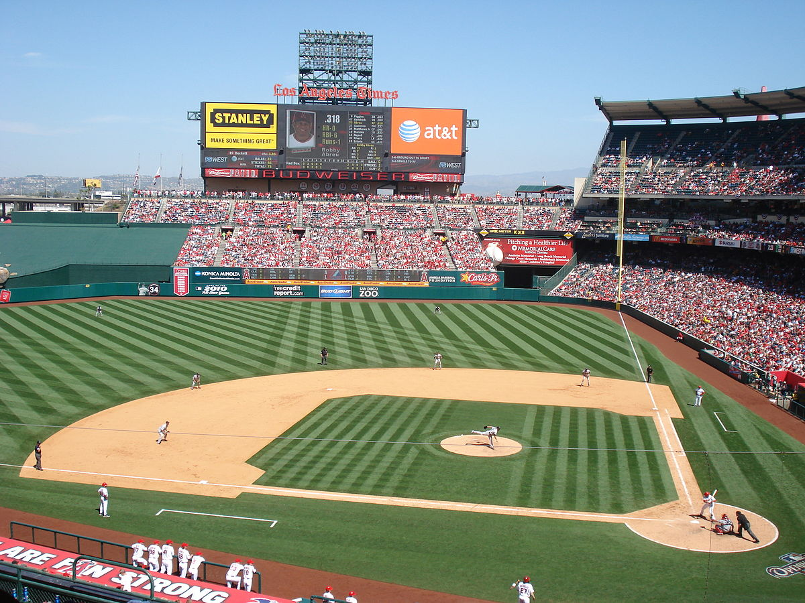
Baseball
Group 9 : Aaditya Kalra & Di-Heng Liu

Slide 2
Introduction
Baseball is a bat-and-ball game played between two teams of at least 9 players each. They play the game on a field with a diamond shaped circuit of four bases. Every game is composed of 9 innings, and two teams switch the position between batting and fielding during each inning.

Slide 3
Statistics and analytics are quite important for baseball, so our python program is going to manage the players’ information, such as name, team, at bats, run scored, etc. This program will also help us to compute the batting average and the slugging percentage.
Objective

Slide 4
Program Description
Given the text file with the players statistics
Split the players into different lists
Identified players of each team
Compute hits, batting avenge and slugging percentage

Slide 5
Commands
QUIT
HELP
TEAM identifier
REPORT n HITS
REPORT n BATTING
REPORT n SLUGGING

Slide 6
Text File 687 Observations
The given text file includes:
player’s name (string)
team identifier (string)
games played (integer)
at bats (integer)
runs scored (integer)
hits (integer)
doubles (integer)
triples (integer)
homeruns (integer)

Slide 7
Players’ Sample
De Aza, Alejandro; CWS; 153; 607; 84; 160; 27; 4; 17Hunter, Torii; DET; 144; 606; 90; 184; 37; 5; 17Hamilton, Josh; LAA; 151; 576; 73; 144; 32; 5; 21Choo, Shin-Soo; CIN; 154; 569; 107; 162; 34; 2; 21Upton, Justin; ATL; 149; 558; 94; 147; 27; 2; 27Cabrera, Miguel; DET; 148; 555; 103; 193; 26; 1; 44Posey, Buster; SF; 148; 520; 61; 153; 34; 1; 15Suzuki, Ichiro; NYY; 150; 520; 57; 136; 15; 3; 7,…

Slide 8
Data Structure
We used several types of data structure, such as input, while, if-else, print, return, for loops, etc
Itemgetter was used to sort the players stats alphabetically or in descending order.

Slide 9
Computing Formula
singles = hits - (doubles + triples + homeruns)
total bases = singles + 2*doubles + 3*triples + 4*homeruns
batting average = (hits) / (at bats)
slugging percentage = (total bases) / (at bats)

Slide 10
Program Function
Main
Batting
Team
Hits
Slugging

Slide 11
Team Identifier
In team identifier program, the user will be prompted to enter the name of team, then every players’ information will immediately show up on the screen with different stats.

Slide 12
Teams Identifier Output
Name | De Aza, Alejandro
Team | CWS
Games Played | 153
At Bats | 607
Runs Scored | 84
Hits | 160
Doubles | 27
Triples | 4
Homeruns | 17
Batting Average | 0.264
Slugging Percentage | 0.405

Slide 13
Report Hits, Batting and Slugging
Name | Hits
Cabrera, Miguel | 193
Name | BatAvg
Cabrera, Miguel | 0.348
Name | SlugPer
Cabrera, Miguel | 0.636

Slide 14
Program Usefulness
It will help people who are interesting in baseball game and team managers who are looking to sign new players.

Slide 15
Thank You
Let’s go to Python
and run our program

